Slide 1

ECE 1710: Power Distribution Systems Engineering and Smart Grids
Lecture 4
Dr. Robert Kerestes
University of Pittsburgh
Swanson School of Engineering
Department of Electrical and Computer Engineering
Notes:
Instructions for editing school and department titles:
Select from menu: View > Master > Slide Master
Click on each text area you wish to edit. Text will become editable.

Slide 2
Outline
Module #1: Voltage drop
Module #2: Line impedance
Module #3: Three-Phase Circuit Caluculations
Module #4: Linear Ladder Network
Module #5: Ladder Iterative Power Flow

Slide 3
Learning Objectives
Learning Objectives:
Use phasor diagrams to visually describe voltage drops in electric power systems.
Carry out impedance calculations for transposed overhead transmission lines.
Calculate single-phase ratings based off of three-phase ratings
Calculate the voltages of a linear ladder network
Perform a power flow for a nonlinear ladder network

Slide 4
Voltage drop

Slide 5
Voltage Drop
In distribution systems, a feeder provides service to unbalanced three-phase, two-phase, and single-phase loads over untransposed three-phase, two-phase, and single-phase line segments.
Leads to unbalanced three-phase voltages and currents.
Requires accurate modeling, for highest fidelity models symmetrical components will not work
Often an approximate model will suffice. These models assume:
Balanced loads
Perfectly transposed line segments.

Slide 6
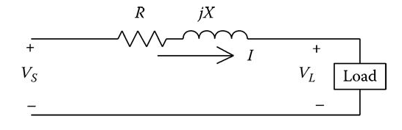
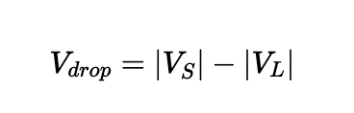
Voltage Drop
A line-to-neutral equivalent circuit of a three-phase line segment serving a balanced three-phase load is shown below:
Voltage drop is defined as:

Slide 7
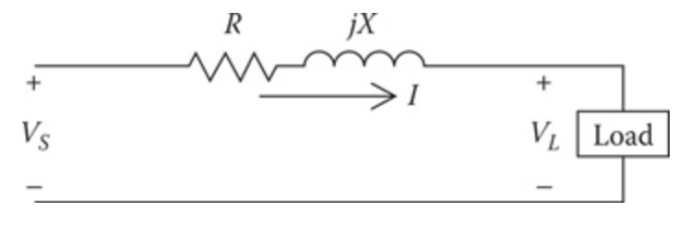
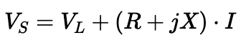
Voltage Drop
Using KVL we have

Slide 8
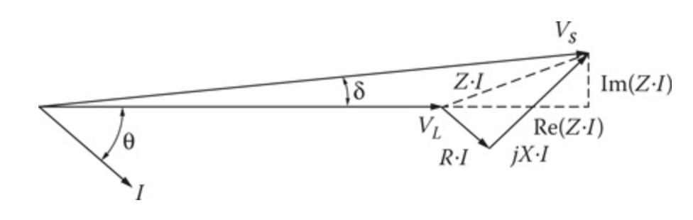
Voltage Drop
Using phasors we can approximate voltage drop:
Note: Most power systems loads are lagging, so the current lags the voltage at the load.

Slide 9
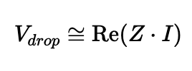
Voltage Drop
As long as $δ$ is small, as is the case with most distribution circuits, we can say that

Slide 10
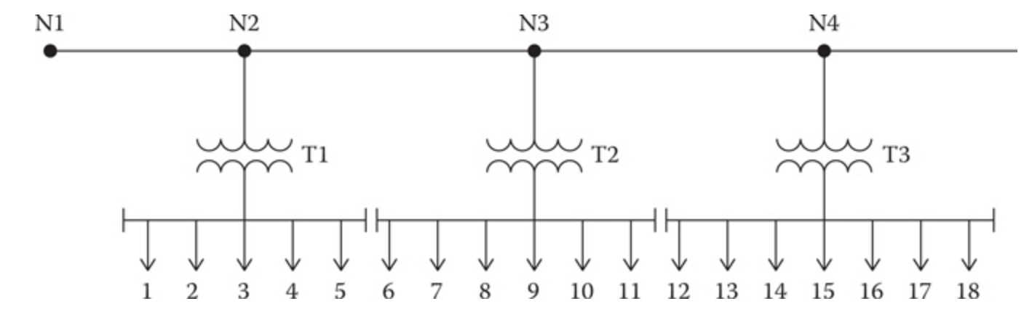
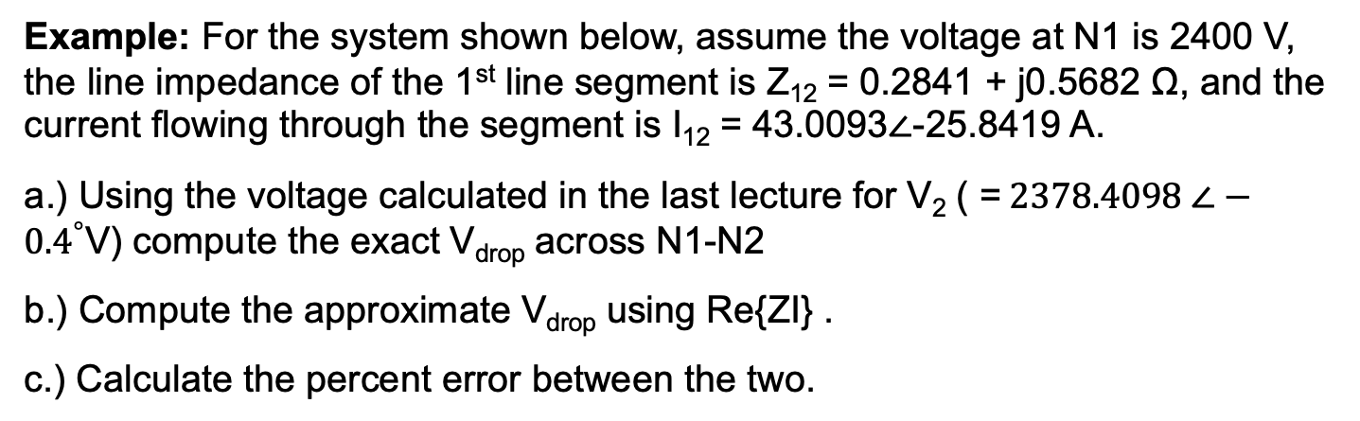
Example: For the system shown below, assume the voltage at N1 is 2400 V, the line impedance of the 1st line segment is Z₁₂ = 0.2841 + j0.5682 Ω, and the current flowing through the segment is I₁₂ = 43.0093∠-25.8419 A.
a.) Using the voltage calculated in the last lecture for V₂ ( =$2378.4098 ∠−{0.4}^{°}$V) compute the exact V_{drop} across N1-N2
b.) Compute the approximate V_{drop} using Re{ZI} .
c.) Calculate the percent error between the two.

Slide 11
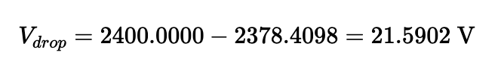
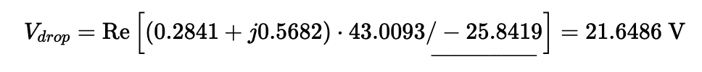
Solution: (a) Using the formula $V_{drop}=\left|V_{S}\right|−\left|V_{L}\right|=\left|V_{1}\right|−\left|V_{2}\right|$, we have
(b) Recall the impedance of the line for the first segment is $Z=0.2841+j0.5682 Ω$. Using the formula $V_{drop}≈\text{Re}[ZI]$, we have

Slide 12
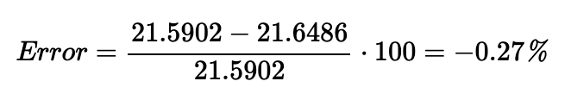
(c) The percent error between the two methods is

Slide 13
Line impedance

Slide 14
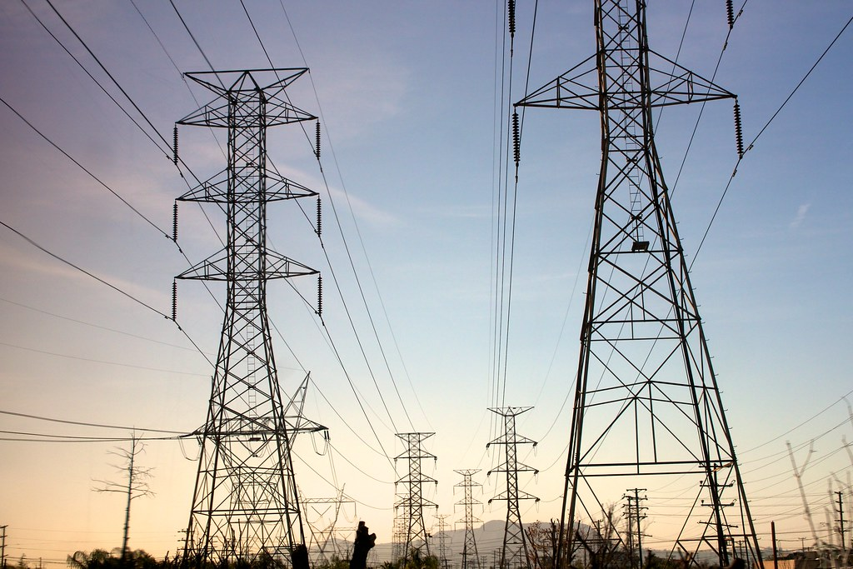
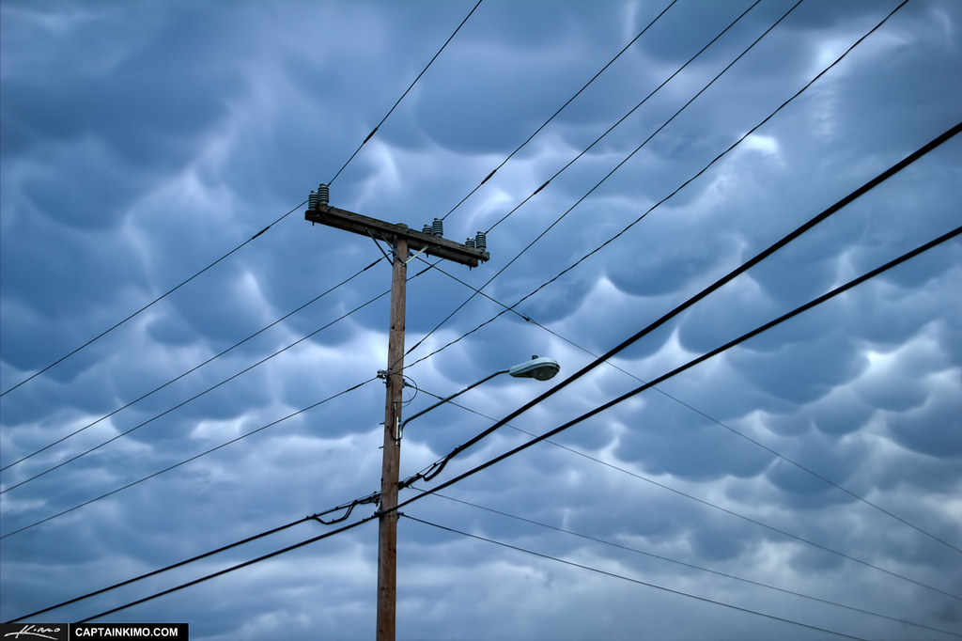
Line impedance
Types of Power Lines
Transmission Level [1]
Distribution Level [2]

Slide 15
Line impedance
For the approximate modeling of a line segment, it will be assumed that the line segment is transposed. This means that the line is balanced (meaning the impedance in each phase is equal.
a
c
b
b
a
c
c
b
a
Line Transposition

Slide 16
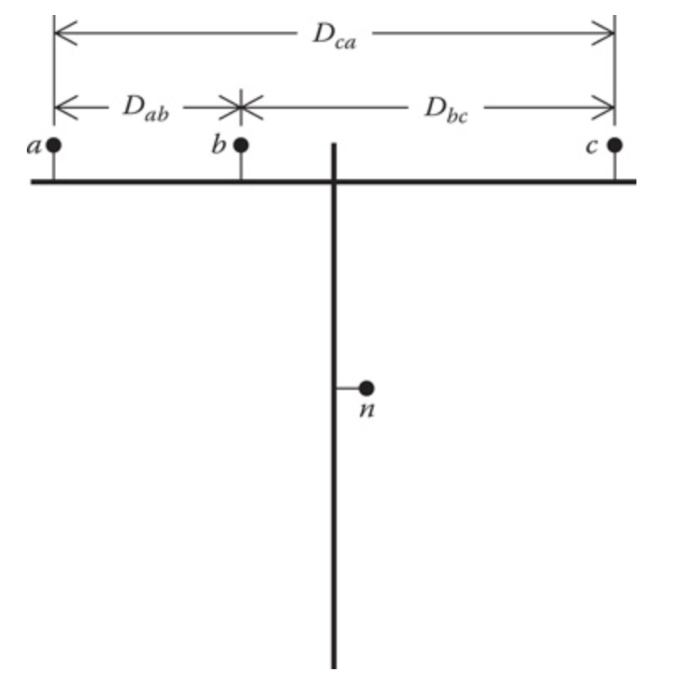
A typical three-phase line configuration

Slide 17
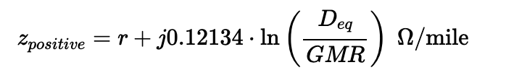
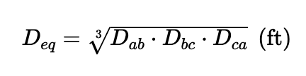
Line impedance
The equation for the positive sequence impedance is given by
where

Slide 18
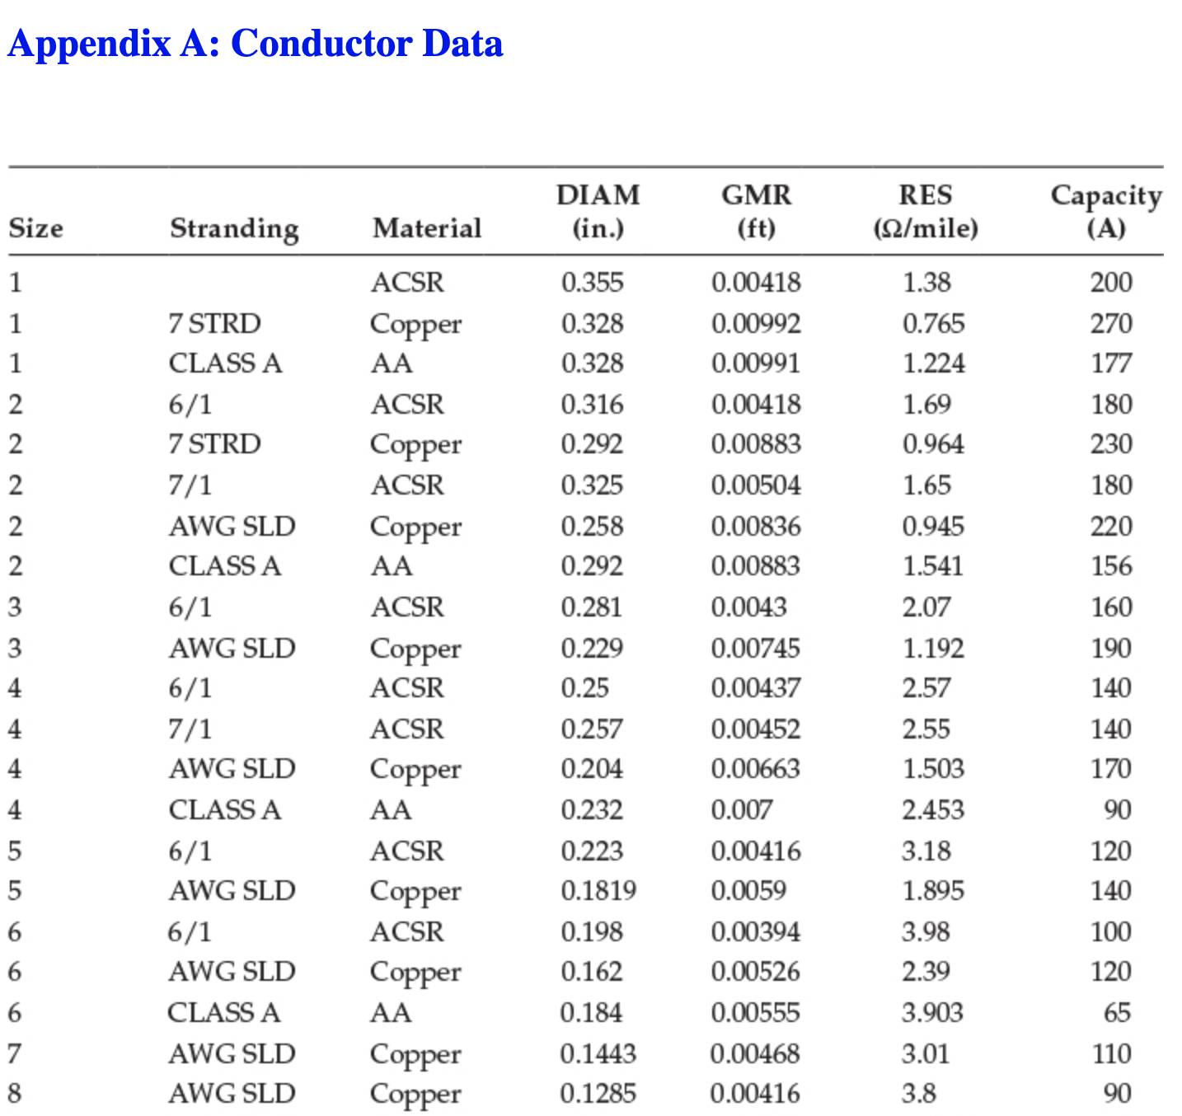

Slide 19
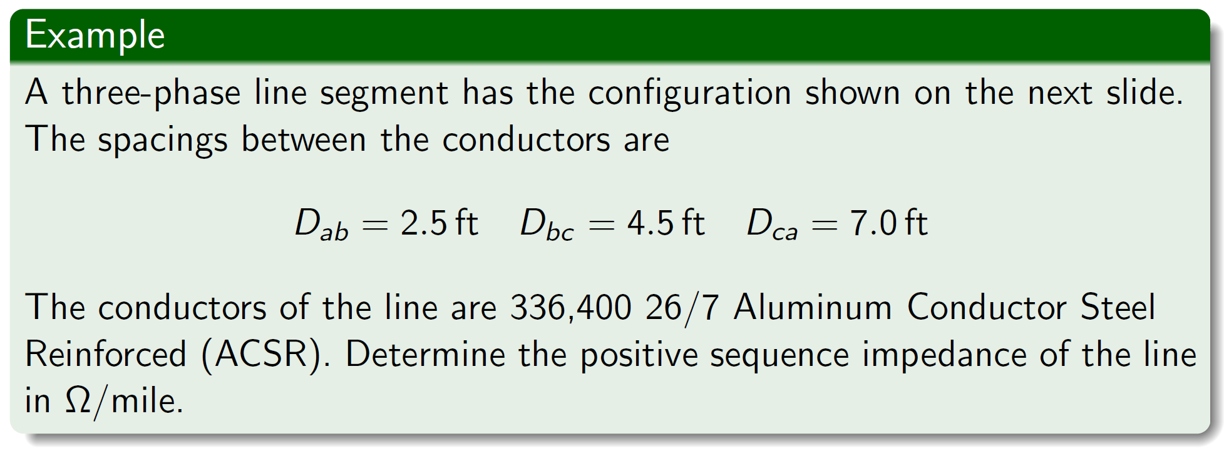
Line impedance

Slide 20
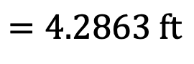
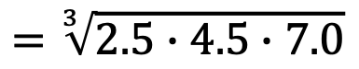
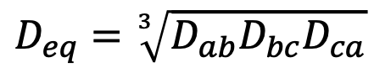
Line impedance
$$D_{eq}=\sqrt[3]{D_{ab}D_{bc}D_{ca}}$$
$$=\sqrt[3]{2.5∙4.5∙7.0}$$
$$=4.2863 \text{ft}$$

Slide 21
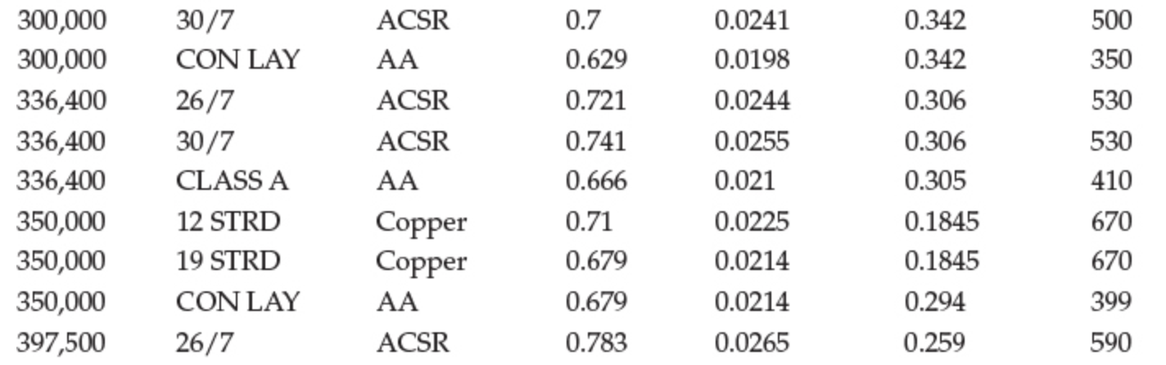
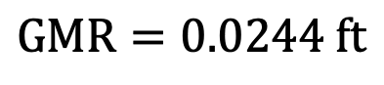
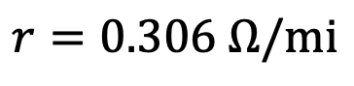
Line impedance
Conductor type
GMR
Resistance
$$r=0.306 Ω/\text{mi}$$
$$\text{GMR}=0.0244 \text{ft}$$

Slide 22
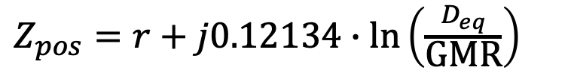
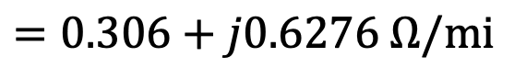
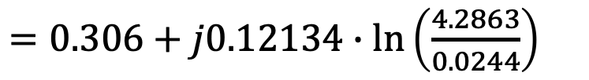
Line impedance
Solution:
$Z_{pos}=r+j0.12134∙\ln\left(\frac{D_{eq}}{\text{GMR}}\right)$
$=0.306+j0.12134∙\ln\left(\frac{4.2863}{0.0244}\right)$
$$=0.306+j0.6276 Ω/\text{mi}$$

Slide 23
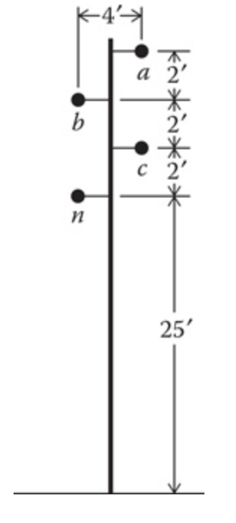
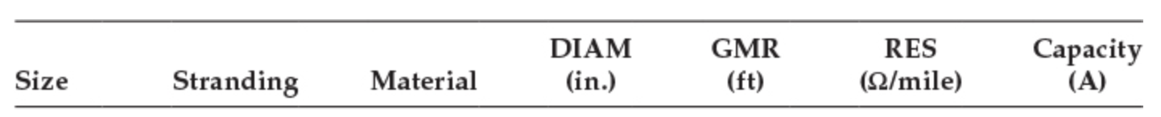
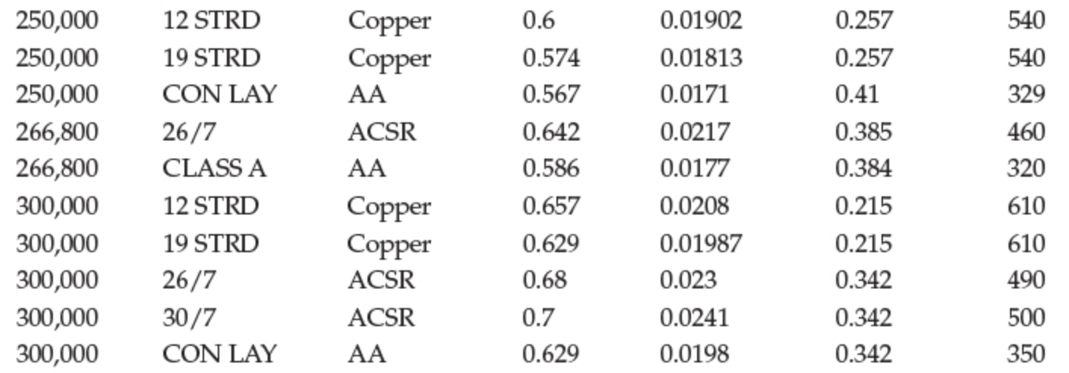
Line impedance
For the pole shown, the conductors are 250,000 cm, CON Lay, and AA. The nominal line-to-line voltage of the feeder is 14.4 kV.
Question: What is the resistance per mile?

Slide 24
Line impedance
For the pole shown, the conductors are 250,000 cm, CON Lay, and AA. The nominal line-to-line voltage of the feeder is 14.4 kV.
Question: What is GMR?

Slide 25
Line impedance
For the pole shown, the conductors are 250,000 cm, CON Lay, and AA. The nominal line-to-line voltage of the feeder is 14.4 kV.
Question: Calculate $D_{eq}$ and round to two decimal places

Slide 26
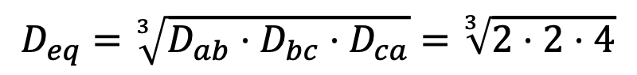
Line impedance
Question: Calculate $D_{eq}$ and round to two decimal places
$$D_{eq}=\sqrt[3]{D_{ab}⋅D_{bc}⋅D_{ca}}=\sqrt[3]{2⋅2⋅4}$$
$$D_{eq}=2.52′$$

Slide 27
Three-Phase Circuit Calculations

Slide 28
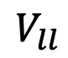
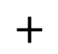
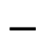

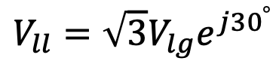
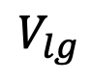
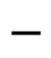
Three-Phase Circuit Calculations
Module #5
As we’ve seen earlier in this lecture, some parts of power systems circuits have three-phases
Line-to-line voltage
$$+$$
$$V_{ll}$$
$$−$$
Relationship between line-to-line and line-to-ground voltages
$$+$$
Line-to-ground voltage
$$V_{ll}=\sqrt{3}V_{lg}e^{j{30}^{°}}$$
$$V_{lg}$$
$$−$$

Slide 29

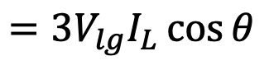
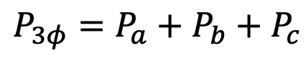
Three-Phase Circuit Calculations
Module #5
The currents in each of the lines are denoted by $I_{L}$. Since the circuit is balanced, each of the voltages and currents are equal for each phase. We can then calculate real power using
$$P_{3φ}=P_{a}+P_{b}+P_{c}$$
$$=V_{lg}I_{L}\cos{θ}+V_{lg}I_{L}\cos{θ}+V_{lg}I_{L}\cos{θ}$$
$$={3V}_{lg}I_{L}\cos{θ}$$

Slide 30
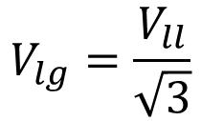
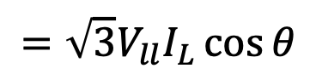
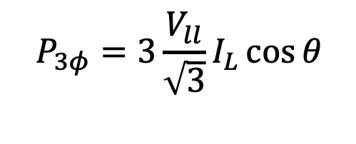
Three-Phase Circuit Calculations
Module #5
However, if we want to use rms line-to-line voltages instead we can replace the rms line-to-ground voltages with
$$V_{lg}=\frac{V_{ll}}{\sqrt{3}}$$
substituting
$$P_{3φ}=3\frac{V_{ll}}{\sqrt{3}}I_{L}\cos{θ}$$
$$={\sqrt{3}V}_{ll}I_{L}\cos{θ}$$

Slide 31
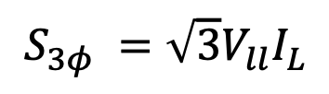
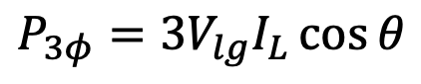
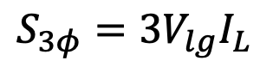
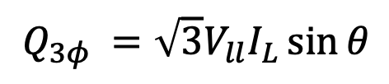
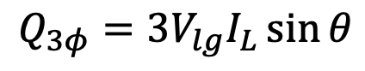
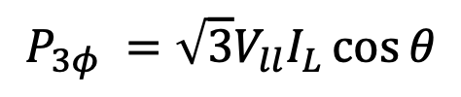
Three-Phase Circuit Calculations
Module #5
We can do the same thing with reactive and apparent power giving us
$$P_{3φ}={3V}_{lg}I_{L}\cos{θ}$$
or
$$P_{3φ} ={\sqrt{3}V}_{ll}I_{L}\cos{θ}$$
$$Q_{3φ}={3V}_{lg}I_{L}\sin{θ}$$
or
$$Q_{3φ} ={\sqrt{3}V}_{ll}I_{L}\sin{θ}$$
$$S_{3φ}={3V}_{lg}I_{L}$$
or
$$S_{3φ} ={\sqrt{3}V}_{ll}I_{L}$$

Slide 32
Three-Phase Circuit Calculations
Module #5
Note ratings of equipment and in power systems is almost always given in terms of line-to-line voltages!!
However, you should be familiar with both line-to-line and line-to-ground voltage levels.

Slide 33
Linear Ladder Network

Slide 34
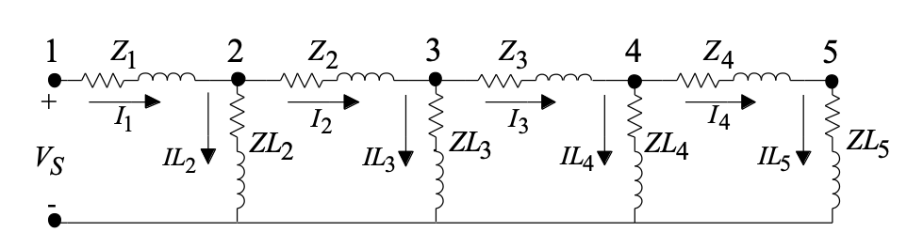
Distribution System Power Flow
A distribution feeder is non-linear because most loads are assumed to be constant kW and kvar. However, the approach taken for a linear system can be modified to account for the non-linear characteristics of the distribution feeder.
Linear Ladder Network

Slide 35
Linear Ladder Network
First let’s look at a linear network to compare. The loads here are defined as constant impedance loads.
Linear Ladder Network

Slide 36
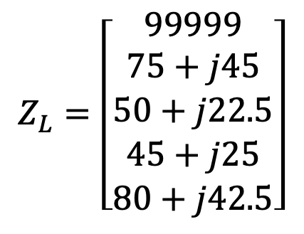

Linear Ladder Network
Linear Ladder Network
This systems has line impedances of:
This system has load impedances of:
$$Z_{L}=\left[\begin{matrix}99999 \\ 75+j45 \\ \begin{aligned}50+j22.5 \\ 45+j25 \\ 80+j42.5\end{aligned}\end{matrix}\right]$$
$$Z_{line}=\left[\begin{matrix}0.1739+j0.3564 \\ 0.1449+j0.3970 \\ \begin{aligned}0.1159+j0.2376 \\ 0.2028+j0.4158\end{aligned}\end{matrix}\right]$$

Slide 37


Linear Ladder Network
Linear Ladder Network
This means all voltages are the same
Initially start with all currents equal to zero:
$$I_{start}=\left[\begin{aligned}0 \\ 0 \\ 0 \\ 0 \\ 0\end{aligned}\right]$$
$$V_{start}=\left[\begin{aligned}7200 \\ 7200 \\ 7200 \\ 7200 \\ 7200\end{aligned}\right]$$

Slide 38


Linear Ladder Network
Linear Ladder Network
We can then ”update” the voltages and currents using ohm’s law and KVL. For example
$$IL_{5}=\frac{7200}{80+j42.5}=79.5 ∠−{27.98}^{∘} A$$
$$V_{5}=7200$$

Slide 39

Linear Ladder Network
Linear Ladder Network
We can then ”update” the voltages and currents using ohm’s law and KVL. For example
$I_{4}={IL}_{5}+I_{5}=$ $\left(79.5∠{−27.98}^{∘}\right)+0=79.5∠{−27.98}^{∘} A$
$$V_{4}=V_{5}+I_{4}Z_{4}=7200+(79.5∠{−27.98}^{∘})(0.2029+j0.4158)$$
$$V_{4}=7229.8∠ {0.17}^{∘} V$$

Slide 40



Linear Ladder Network
Linear Ladder Network
We then continue the process back to the source voltage computing
$${IL}_{i}=\frac{V_{i}}{ZL_{i}}$$
$$I_{i−1}={IL}_{i}+I_{i}$$
$$V_{i−1}=V_{i}+I_{i−1}Z_{i−1}$$

Slide 41


Linear Ladder Network
This algorithm is shown in the following Mathcad routine
$${V_{s}=V}_{1}=7529.1 ∠{1.98}^{∘} V$$
However, we know the source voltage is 7200 volts rather than the load, therefore we need to correct this

Slide 42



Linear Ladder Network
The ratio of source to load is
$$ratio=\frac{V_{s}}{V_{5}}=\frac{7529.1∠{1.98}^{∘}}{7200}$$
$$ratio=0.9557 − j0.0331$$
We can use the to correct for a source voltage of 7200 V:
$$ratio=0.9557 − j0.0331$$

Slide 43

Linear Ladder Network
The ratio of source to load is
$V_{start}=ratio⋅$ $=\left[\begin{aligned}6885.2∠−{1.98}^{∘} \\ 6885.2∠−{1.98}^{∘} \\ 6885.2∠−{1.98}^{∘} \\ 6885.2∠−{1.98}^{∘} \\ 6885.2∠−{1.98}^{∘}\end{aligned}\right]$

Slide 44



Linear Ladder Network
Running the algorithm again with the new start values produces
$$I=\left[\begin{matrix}417.7∠−29.32 \\ 337.0∠−28.75 \\ \begin{aligned}210.3∠−30.54 \\ 76.0∠−29.96 \\ 0\end{aligned}\end{matrix}\right]$$
$$V=\left[\begin{matrix}7200.0∠0.00 \\ 7064.4∠ −0.76 \\ \begin{aligned}6959.2∠ −1.55 \\ 6913.7∠−1.81 \\ 6885.2∠−1.98\end{aligned}\end{matrix}\right]$$
$$IL=\left[\begin{matrix}0 \\ 80.8∠−31.73 \\ \begin{aligned}126.9∠−25.78 \\ 134.3∠−30.87 \\ 76.0∠29.96\end{aligned}\end{matrix}\right]$$

Slide 45


Linear Ladder Network
And a voltage drop% of
$$vdrop_{\%}=\frac{\left|V_{1}\right|−|V_{5}|}{|V_{1}|}×100=\frac{7200−6885.2}{7200}×100\%$$
$$vdrop_{\%}=4.3716 \%$$

Slide 46
Ladder Iterative Power Flow

Slide 47
Ladder Iterative Power Flow
The power flow problem is a nonlinear circuit analysis problem as opposed to a linear circuit analysis problem that a student may be familiar with from a circuits class.
Power Flow Program
Inputs:
Load power (kW & kvar, kW & pf, or kVA & pf)
Equipment impedances and connections
Source voltage levels
Outputs (calculates):
System voltages
System currents
System power flows and losses

Slide 48

Ladder Iterative Power Flow
The following shows a nonlinear network. This is similar to the linear network covered in the previous module, however, the loads are now constant power loads rather than constant impedance.
Nonlinear Ladder Network

Slide 49
Ladder Iterative Power Flow
Due to the nonlinear nature of the network, we will now have to iterative towards a solution.
This iterative process is called the forward sweep-backward sweep.
Nonlinear Ladder Network

Slide 50

Ladder Iterative Power Flow
For the forward sweep, we will start by assuming all currents are zero and compute the voltage at all of the nodes
$V_{j}=V_{j−1}−I_{j−1}Z_{j−1}=V_{j−1}+0=V_{j−1}$
$for j=2, 3…,N$
Forward Sweep
Nonlinear Ladder Network

Slide 51

Ladder Iterative Power Flow
After the forward sweep, we will then compute all load currents using the following equation
$${IL}_{i}={\left(\frac{SL_{i}}{V_{i}}\right)}^{∗}$$
$for i=N,N−1,…2$
Nonlinear Ladder Network

Slide 52
Ladder Iterative Power Flow
The backward sweep will then compute all currents all the way back to the source current
Backward Sweep
Nonlinear Ladder Network

Slide 53

Ladder Iterative Power Flow
These currents can be calculated starting at the last node working backwards, using the equation
$$I_{i−1}=I_{i}+IL_{i}$$
$for i=N,N−1,…2$
Nonlinear Ladder Network

Slide 54

Ladder Iterative Power Flow
We then perform the forward sweep again, except this time the currents are nonzero so we will use KVL to calculate each voltage using
$$V_{j}=V_{j−1}−I_{j−1}Z_{j−1}$$
$for j=2, 3…,N$
Forward Sweep
Nonlinear Ladder Network

Slide 55

Ladder Iterative Power Flow
We then continue to iterate through the forward sweep-backward sweep until our solution has converged. That is
$$error_{i}^{(n)}=\frac{|V_{i}^{\left(n\right)}−V_{i}^{(n−1)}|}{V_{nominal}}≤specified tolerance$$
where
$$n=n^{th} iteration of the iterative process$$

Slide 56



Ladder Iterative Power Flow
For an example, we will use the same system as in the linear network example, but will change the loads to be constant power.
$$V_{s}=7200$$
Our convergence tolerance will be
$$tol=0.001$$

Slide 57


Ladder Iterative Power Flow
Starting with a voltages and currents equal to zero for the zero^{th} iteration i.e.
$$start= \left[\begin{matrix}0 \\ 0 \\ \begin{aligned}0 \\ 0 \\ 0\end{aligned}\end{matrix}\right]$$
and
$${\left[V\right]}_{old}=\left[I\right]=start$$

Slide 58

Ladder Iterative Power Flow
For the first forward sweep, since all currents are zero we get
$$\left[V\right]=\left[\begin{matrix}7200 \\ 7200 \\ \begin{aligned}7200 \\ 7200 \\ 7200\end{aligned}\end{matrix}\right]$$
Before calculating our currents we need to check our error
$$error=\frac{|V−V_{old}|}{V_{nominal}}=\left[\begin{aligned}1 \\ 1 \\ 1 \\ 1 \\ 1\end{aligned}\right]$$

Slide 59

Ladder Iterative Power Flow
Then calculating the load currents with
$${IL}_{i}={\left(\frac{SL_{i}}{V_{i}}\right)}^{∗}$$
we get
$$\left[IL\right]=\left[\begin{matrix}0∠0^{∘} \\ 81.0∠{−30.96}^{∘} \\ \begin{aligned}127.3∠{−25.87}^{∘} \\ 131.0∠{−32.01}^{∘} \\ 76.2∠{−30.07}^{∘}\end{aligned}\end{matrix}\right] A$$

Slide 60

Ladder Iterative Power Flow
We then perform the backward sweep using
$$I_{i−1}=I_{i}+IL_{i}$$
we get
$$\left[I\right]=\left[\begin{matrix}415.2∠{−29.57}^{∘} \\ 334.2∠{−29.23}^{∘} \\ \begin{aligned}207.2∠{−31.29}^{∘} \\ 76.2∠{−30.07}^{∘} \\ 0∠{0.00}^{∘}\end{aligned}\end{matrix}\right] A$$

Slide 61

Ladder Iterative Power Flow
We then increment the iteration n and run through he sweep again, i.e.
Forward Sweep
$$V_{j}=V_{j−1}−I_{j−1}Z_{j−1}$$
Check convergence criteria
$$error=\frac{|V−V_{old}|}{V_{nominal}}≤tol ?$$
If no, update ”old” voltages
$$V_{old}=V$$

Slide 62

Ladder Iterative Power Flow
We then increment the iteration n and run through he sweep again, i.e.
Then calculate load currents
${IL}_{i}={\left(\frac{SL_{i}}{V_{i}}\right)}^{∗}$
Backward sweep
$$I_{i−1}=I_{i}+IL_{i}$$
Increment iteration n and repeat

Slide 63

Ladder Iterative Power Flow
After four iterations our solution converges with
$$n=4$$
$$\left[V\right]=\left[\begin{matrix}7200∠0^{∘} \\ 7057.1∠{−0.75}^{∘} \\ \begin{aligned}6944.6∠{−1.53}^{∘} \\ 6896.3∠{−1.78}^{∘} \\ 6865.5∠{−1.96}^{∘}\end{aligned}\end{matrix}\right] V$$
$$\left[IL\right]=\left[\begin{matrix}0∠0^{∘} \\ 82.6∠{−31.72}^{∘} \\ \begin{aligned}132.0∠{−27.39}^{∘} \\ 136.8∠{−33.79}^{∘} \\ 79.9∠{−32.02}^{∘}\end{aligned}\end{matrix}\right] A$$

Slide 64

Ladder Iterative Power Flow
$$\left[I\right]=\left[\begin{matrix}430.9∠{−31.11}^{∘} \\ 348.3∠{−30.96}^{∘} \\ \begin{aligned}216.7∠{−33.13}^{∘} \\ 79.9∠{−32.02}^{∘} \\ 0∠{0.00}^{∘}\end{aligned}\end{matrix}\right] A$$
$$V_{drop}\%=\frac{V_{s}−V_{5}}{V_{s}}×100\%=4.66 \%$$

Slide 65
Reference Materials
[1] "Power transmission lines" by Oran Viriyincy is licensed under CC BY-SA 2.0.
[2] "Telephone-Pole-and-Electric-Powerlines-with-Cloudy-Storm-Sky" by Captain Kimo is licensed under CC BY-NC-ND 2.0.

